Slide 1
Applied Machine Learning for Educational Data Scientists
EDLD 654
Joe Nese
Daniel Anderson

Slide 2
An Introduction to the Course
Week 1, Class 2

Slide 3
Agenda
Introductions
About the course
Syllabus
Kaggle

Slide 4
About Me
BA: UC Santa Barbara
PhD, School Psychology: University of Maryland
Behavioral Research & Teaching (BRT) since 2009
Research Associate Professor
Research
Applied statistical methods to measure and monitor student growth
Inform the applied research methodologies used by researchers
Developing and improving systems that support data-based decision making using advanced technologies to influence teachers’ instructional practices and increase student achievement
CORE and CORE II
Teaching
EDLD 651 – Introduction to Data Science with R
EDLD 654 – this one!

Slide 5
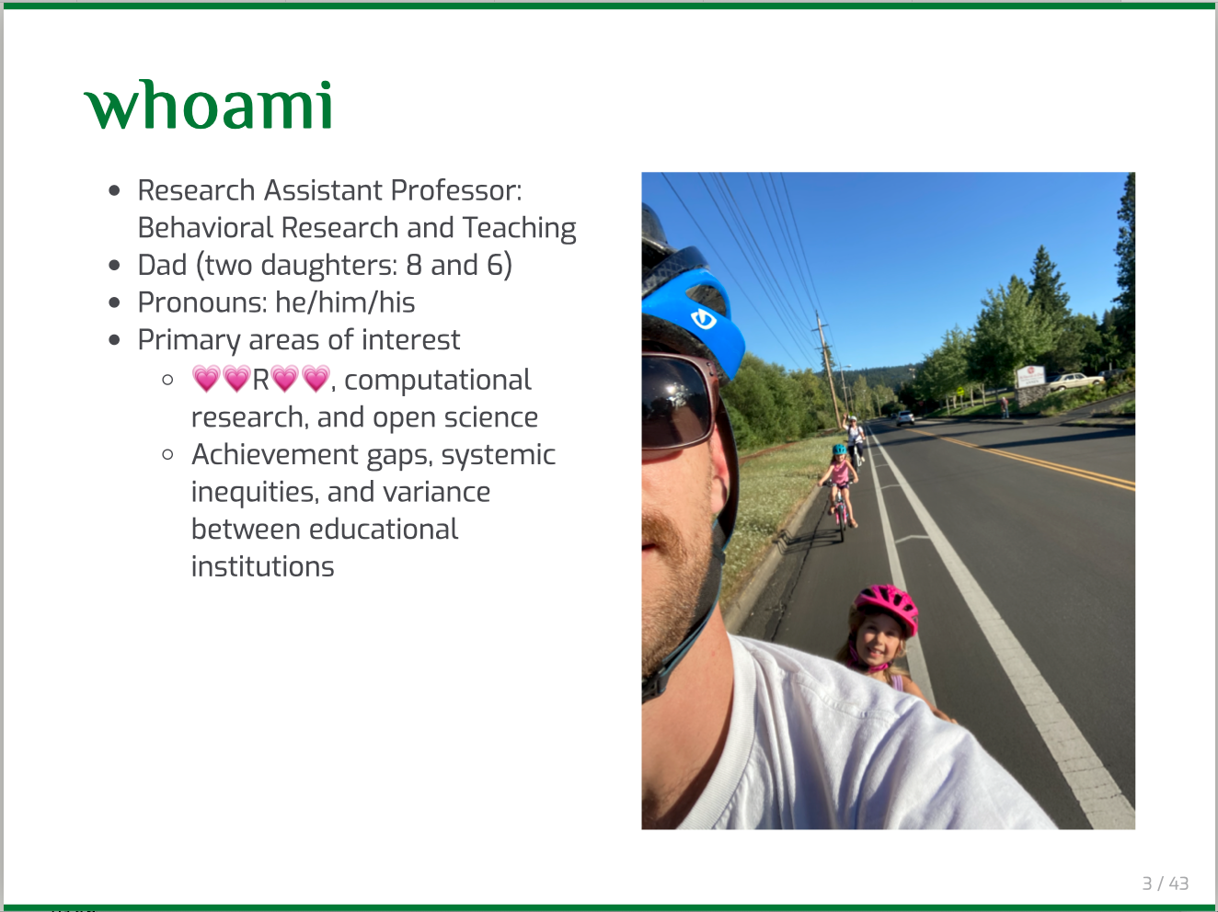

Slide 6
About You
Please introduce yourself
Name and program/year of study
How are you doing?
Tell me whatever you’d like the class to know

Slide 7
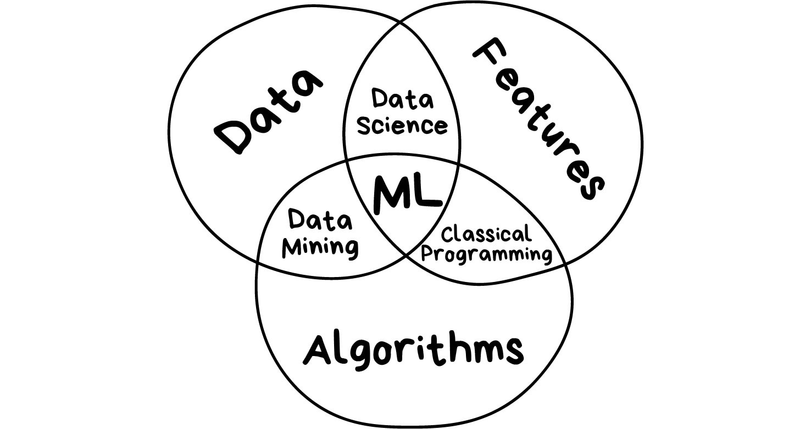
https://vas3k.com/blog/machine_learning/

Slide 8
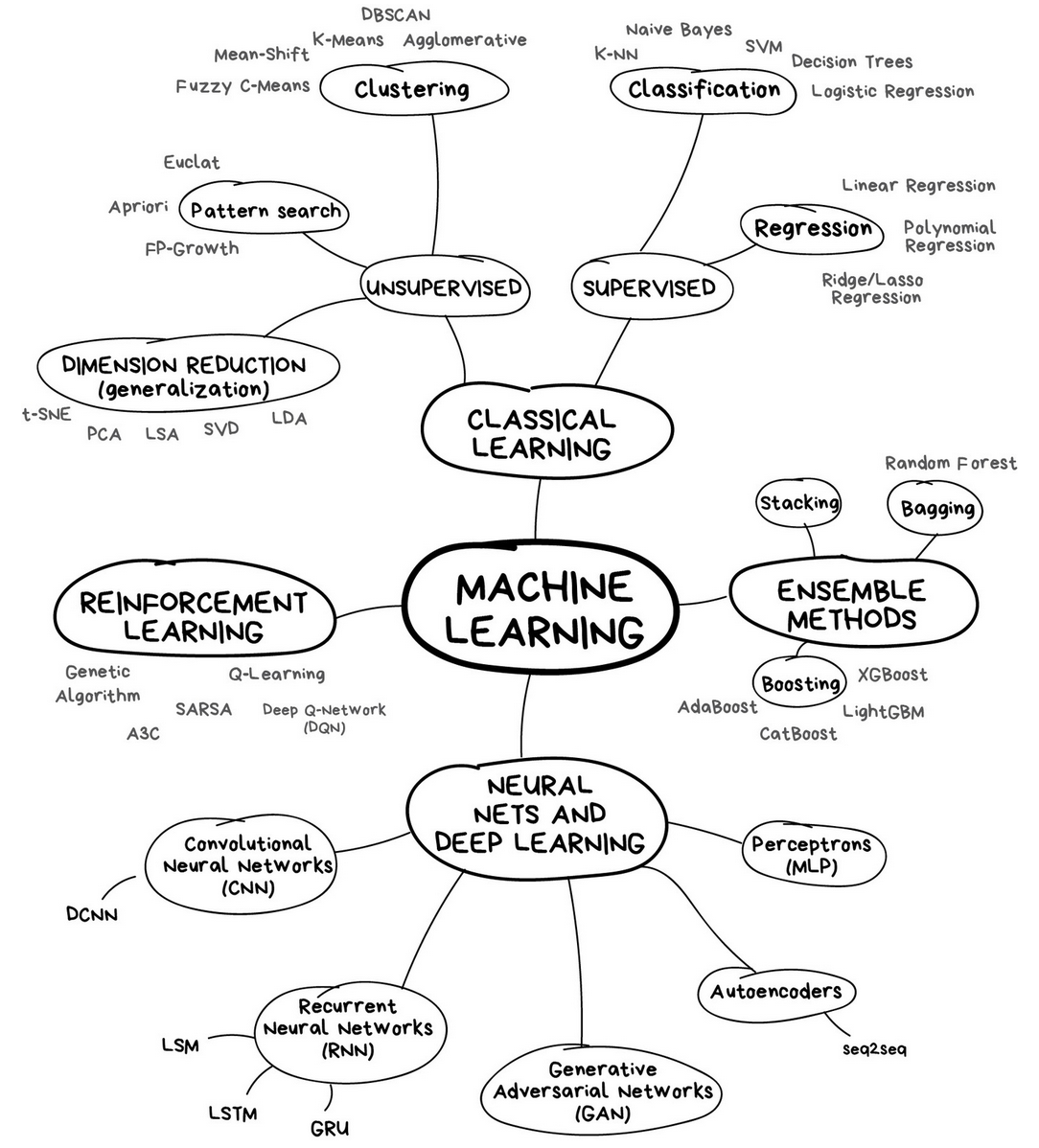
Inference vs. Prediction
ML Ethics
Variable Selection
Feature Engineering
Bias-Variance Tradeoff
https://vas3k.com/blog/machine_learning/

Slide 9
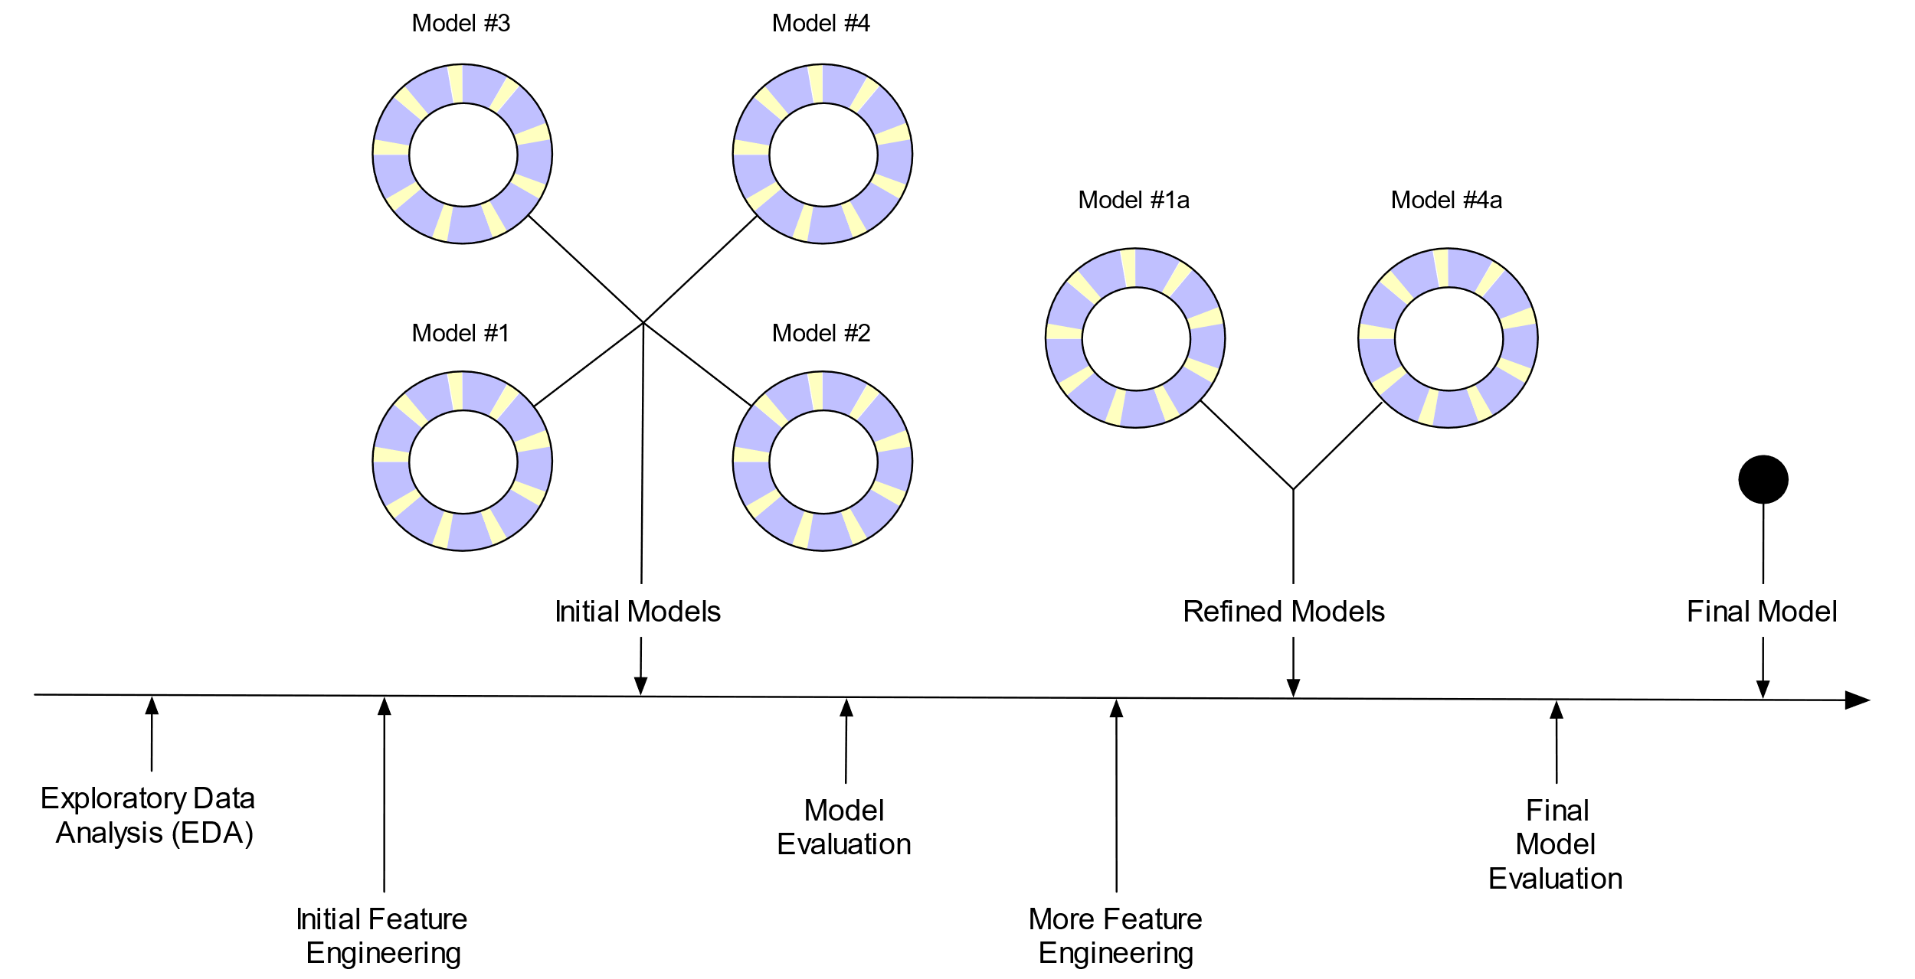
ML Modeling Process
Kuhn & Silge (2020)

Slide 10
Housekeeping
Course website: https://uo-datasci-specialization.github.io/c4-ml-fall-2020/index.html
Syllabus: https://uo-datasci-specialization.github.io/c4-ml-fall-2020/site-syllabus.html
Schedule: https://uo-datasci-specialization.github.io/c4-ml-fall-2020/schedule.html
Assignments: https://uo-datasci-specialization.github.io/c4-ml-fall-2020/assignments.html
Course github: https://github.com/uo-datasci-specialization/c4-ml-fall-2020
Course Kaggle: https://www.kaggle.com/c/edld-654-fall-2020/overview

Slide 11
How the pandemic affects this course

Slide 12
Remote instruction
In-person format
Present new content
Lab applying learned content
Remote format
Present new content in a Zoom meeting
two instructors to help field questions
Zoom will be recorded, and posted to Canvas to view at a later time if need be
Labs held via zoom
two instructors available to help and answer questions
screen shares
breakout rooms to facilitate individual help as necessary
attendance is encouraged

Slide 13
Practical changes
Expectation is that you still engage with each week’s materials
Communication
Please be open with your communication regarding unexpected interruptions or uncertainties so that we can help
illness
caring for family
technology
Accessibility
students with disabilities or medical conditions that encounter barriers with remote instruction should contact the Accessible Education Center as soon as possible so that appropriate accommodations can be determined

Slide 14
How we can help each other
Patience
Grace
Empathy
Understanding
Open communication

Slide 15
About the course

Slide 16


Slide 17
This class
This class is
an introduction to applied machine learning techniques
experimental
utilizing R
delivered remotely
This class is not
all encompassing
perfectly complete (the field and software change)
an online course

Slide 18
Why R?
R has cutting edge ML models
Some ML developers use R as their primary computing environment and their work often results in R packages
R and R packages are built by people who do data analysis
It is easy to link to other applications
You can implement python, C, C++, tensorflow, keras, stan, or Weka without leaving R
You already know R!

Slide 19
Why not R?
R is a data analysis language, and is not C or Java
If a high-performance deployment is required, R can be a prototyping language
R is mostly memory-bound
But there are plenty of exceptions to this
The interfacing functions have been inconsistent
There are two methods for specifying what a model
formula (y ~ x)
x = x , y = y
Nearly all model functions auto-generate dummy variables
Some packages have an argument for resampling

Slide 20
Syntax for computing predicted class probabilities
Function | Package | Code
lda | MASS | predict(obj)
glm | stats | predict(obj, type = "response")
gbm | gbm | predict(obj, type = "response", n.trees)
mda | mda | predict(obj, type = "posterior")
rpart | rpart | predict(obj, type = "prob")
Weka | RWeka | predict(obj, type = "probability")
logitboost | LogitBoost | predict(obj, type = "raw", nIter)
pamr.train | pamr | pamr.predict(obj, type = "posterior", threshold)
Kuhn (2020)

Slide 21
Syntax for computing predicted class probabilities
Function | Package | Code
lda | MASS | predict(obj)
glm | stats | predict(obj, type = "response")
gbm | gbm | predict(obj, type = "response", n.trees)
mda | mda | predict(obj, type = "posterior")
rpart | rpart | predict(obj, type = "prob")
Weka | RWeka | predict(obj, type = "probability")
logitboost | LogitBoost | predict(obj, type = "raw", nIter)
pamr.train | pamr | pamr.predict(obj, type = "posterior", threshold)

Slide 22
Syntax for computing predicted class probabilities
Function | Package | Code
lda | MASS | predict(obj)
glm | stats | predict(obj, type = "response")
gbm | gbm | predict(obj, type = "response", n.trees)
mda | mda | predict(obj, type = "posterior")
rpart | rpart | predict(obj, type = "prob")
Weka | RWeka | predict(obj, type = "probability")
logitboost | LogitBoost | predict(obj, type = "raw", nIter)
pamr.train | pamr | pamr.predict(obj, type = "posterior", threshold)

Slide 23
Syntax for computing predicted class probabilities
Function | Package | Code
lda | MASS | predict(obj)
glm | stats | predict(obj, type = "response")
gbm | gbm | predict(obj, type = "response", n.trees)
mda | mda | predict(obj, type = "posterior")
rpart | rpart | predict(obj, type = "prob")
Weka | RWeka | predict(obj, type = "probability")
logitboost | LogitBoost | predict(obj, type = "raw", nIter)
pamr.train | pamr | pamr.predict(obj, type = "posterior", threshold)

Slide 24
Syntax for computing predicted class probabilities
Function | Package | Code
lda | MASS | predict(obj)
glm | stats | predict(obj, type = "response")
gbm | gbm | predict(obj, type = "response", n.trees)
mda | mda | predict(obj, type = "posterior")
rpart | rpart | predict(obj, type = "prob")
Weka | RWeka | predict(obj, type = "probability")
logitboost | LogitBoost | predict(obj, type = "raw", nIter)
pamr.train | pamr | pamr.predict(obj, type = "posterior", threshold)

Slide 25
Why tidymodels?
Consistent interface functions and language
Irrespective of modeling package
This makes your workflow consistent across models and projects
RStudio generally makes good products
You are already familiar with the tidyverse
tidymodels has the support of a respected development team
Cutting edge!
taking the place of the well-known and widely-used carat package

Slide 26
Why not tidymodels?
Cutting edge!
currently in development
stable/durable code?
documentation non-existent is growing!
Tidymodels website (launched spring 2020)
Tidy Modeling with R (released on 2020-9-22)
makes it challenging both to learn and to teach
Not the tidyverse
but it is tackling something much larger and more complex
all the packages

Slide 27













Why not tidymodels?
Cutting edge!
currently in development
stable/durable code?
documentation non-existent is growing!
Tidymodels website (launched spring 2020)
Tidy Modeling with R (released on 2020-9-22)
makes it challenging both to learn and to teach
Not the tidyverse
but it is tackling something much larger and more complex
all the packages

Slide 29
tidymodels
This is a lot of packages
Some of these packages work in the background
Others perform specific tasks, small, important tasks in the modeling process
Can be overwhelming, but
we will not be calling all of these directly
you will learn how each of the major packages fit into your ML workflow

Slide 30
Some Resources
Tidy Modeling with R (just released!)
Tidymodels website (recently released!)
Learning to Teach Machines to Learn (Allison Hill)
ML Learning Resources (Bradley Boehmke)
Intro to Tidy ML materials (Allison Hill)
Applied ML materials (Max Kuhn)
Julia Silge blog
screencasts and blogs using {tidymodels} and #TidyTuesday data
Your peers
Your instructors
RStudio Community

Slide 31
Syllabus

Slide 32
Course learning objectives
Describe the framework of machine learning (i.e. supervised vs. unsupervised learning) and how it differs from standard inferential statistics
Discuss the bias-variance tradeoff in supervised learning and apply the concept in making decisions about model selection
Construct various supervised learning models, including linear regression (for prediction rather than inference), penalized regression (ridge/lasso), various decision tree models (including bagged and boosted trees, and random forests), and k-nearest neighbor models
Measure and contrast the performance of various models
Construct models for both classification- and regression-based problems
Conduct feature engineering, including dimension reduction, to increase model performance (and quantify the degree to which model performance changed)

Slide 33



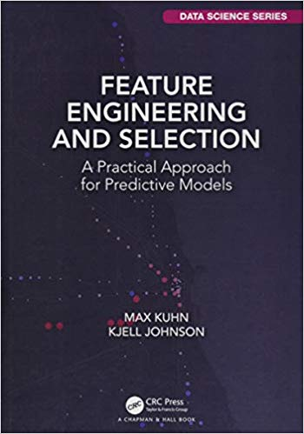
Required Texts (free)

Slide 34

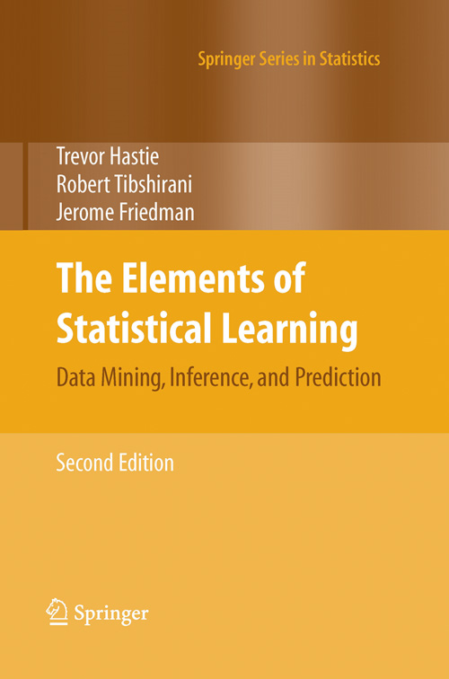

Books not required (but possibly helpful)

Slide 35
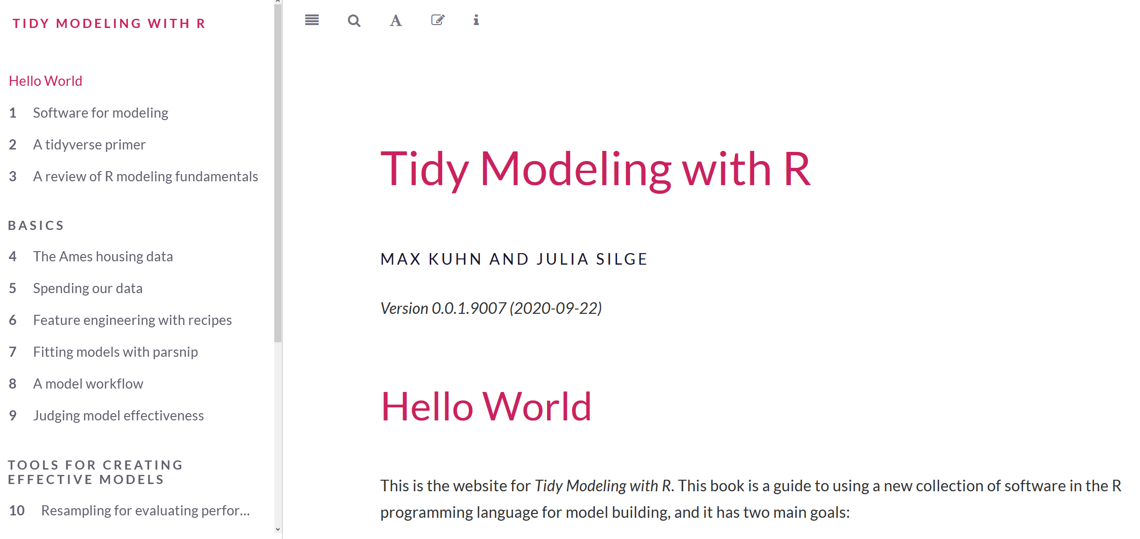
Books not required (but possibly helpful)

Slide 36
Weekly Schedule
Class time M & W – 12:15-1:45
Readings – do before class
New content presented via Zoom
attend to ask questions
recordings will be posted to Canvas
Labs conducted via Zoom
to provide you with practice and time with the instructors to help you puzzle through your problems
what you do not complete in Zoom labs must be completed on your own time

Slide 37
Assignments (200 points total)
Data Quiz (5 points)
Labs (100 points)
Resampling (20 points)
Penalized Regression (20 points)
Feature Engineering (20 points)
K Nearest Neighbors (20 points)
Ensemble Methods (20 points)
Final Project (95 points)
Preliminary fit 1 (10 points)
Preliminary fit 2 (10 points)
Blog post (75 points)
Data description (20 points)
Model fit description (25 points)
Model fits (20 points)
Data visualization (5 points)
Reproducibility (5 points)

Slide 38
Labs
Scored on a “best honest effort” basis
generally, zero or full credit
If you find yourself stuck and unable to proceed, please contact the instructors for help rather than submitting incomplete work
Contacting the instructor is part of the “best honest effort” and can result in full credit for an assignment even if the work is not fully complete.
If the assignment is not complete, and the student has not contacted the instructor for help, it is likely to result is a partial credit score or a zero.
Labs submitted late will be docked by 30% (6 points)
Labs are due a week after they are assigned, before class starts

Slide 39
Final Project
We will be using the kaggle platform to host a local competition
Work as a team to build, tune, evaluate a predictive model based on the training data
Make predictions on the test data that has all the same features (variables) except the outcome
Upload predictions to kaggle, which will provide you with an estimate of your model performance on a portion of the test data (but not the full test data)
At the end of the course, each team’s most performant model will be evaluated against the full test data
this final test regularly leads to changes in the leaderboard ranking for real kaggle competitions
the team with the best model will be awarded five points extra credit.
Link to outside data to help increase the performance of your model (e.g., NCES)

Slide 40
Final Project – Preliminary fits
At Week 6 and Week 8 each team will be required to submit preliminary predictions to kaggle
You may submit predictions at any time, but you must submit your first predictions by Week 6, and predictions from a new model by Week 8
A quantitative indicator of prediction accuracy will automatically be provided
Submissions will be scored on an “all or nothing” basis
If your group provides a set of predictions, you will all receive credit, regardless of the performance of the model

Slide 41
Final Project
Group project, 3 to 4 people
Blog post (or a series of blog posts)
Data description
Describe core features of the data, any additional data you joined in and why, basic descriptives, feature engineering, and data splitting
Model fit description
At least three models must be fit to the data. Describe each model, hyperparameters, assumptions, and a description of what the model is doing and why it is appropriate
Model fits
Describe model fitting procedure(s) and the results of your model evaluation. Compare and contrast the different fits, including a discussion of model performance
Data visualization
Include at least two plots (you may include more) to help communicate your findings
Reproducibility
All code should be housed in a GitHub repository and be fully reproducible

Slide 42
Final Project – Dates
Week 6a (11/2): Preliminary Fit 1
Week 8b (11/18): Preliminary Fit 2
Week 11 (12/7): Final Fits, Blog post (final product) due

Slide 43
Final Project – Scoring Rubric
Criteria | Points possible
Preliminary Fit 1 | 10
Preliminary Fit 2 | 10
Blog Post(s)
Description of the data | 20
Description of the model fits | 25
Model fits | 20
Data visualization | 5
Reproducibility | 5
Total | 95

Slide 44
Grading
Lower percent | Lower point range | Grade | Upper point range | Upper percent
97 | (194 pts) | A+
93 | (186 pts) | A | (194 pts) | 97
90 | (180 pts) | A- | (186 pts) | 93
87 | (174 pts) | B+ | (180 pts) | 90
83 | (166 pts) | B | (174 pts) | 87
80 | (160 pts) | B- | (166 pts) | 83
77 | (154 pts) | C+ | (160 pts) | 80
73 | (146 pts) | C | (154 pts) | 77
70 | (140 pts) | C- | (146 pts) | 73
 |  | F | (140 pts) | 70

Slide 45
Kaggle

